Slide 1
User-Friendly Water, Sanitation and Hygiene in Health Care Facilities
(WASH in HCFs)
Participatory Tool Development
Presented by: Dr. Lim Khankryka, Ministry of Health, Cambodia
Nepal, 11 December 2019

Slide 2
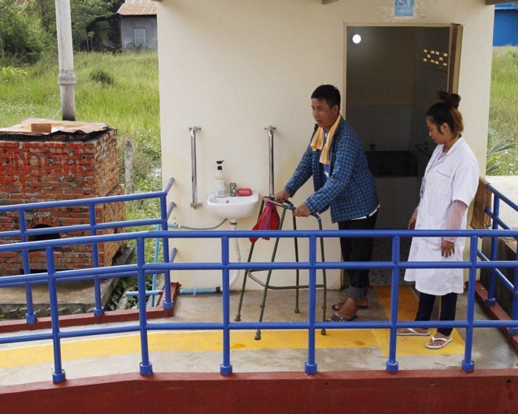
Cambodia’s Public Health Care Facilities (HCFs)
Current Status of WASH in HCFs in Cambodia
National Guideline for WASH in HCFs
Accessible Gap in HCFs
Development of User-Friendly Tool
Learning
Content
WaterAid/Remissa Mak

Slide 3

Cambodia
Cambodia’s Public HCFs
Type of HCF | Number
Health Posts | 129
Health Centers | 1,205
Referral Hospitals | 117
National Hospitals | 9
Source: Department of Planning and Health InformationI, MoH, 2018
Notes:
General summary of Cambodia and relevant stats
In Cambodia, there are now more babies being delivered by health professionals and more women choosing to deliver at a health facility than ever before
A significant decline in the maternal mortality ratio has been reported, from 472 deaths per 100,000 live births in 2005, to 170 deaths per 100,000 live births in 2014 (not shown here)
however demographic and health data show a much slower decrease in the rate of neonatal mortality, which now accounts for half of all deaths in children under-five (explain graphs)
The links between water, sanitation and hygiene interventions and improved maternal and newborn health outcomes have been well established. They are multiple and occur not only during the continuum of care from pregnancy to delivery, and the postpartum period, but also throughout the life of the mother and her child. Within health care facilities, access to safe WASH is particularly important in the prevention and control of infections that can lead to maternal and newborn deaths.
Make sure you talk about quality of care and why WASH in HCF is important??

Slide 4
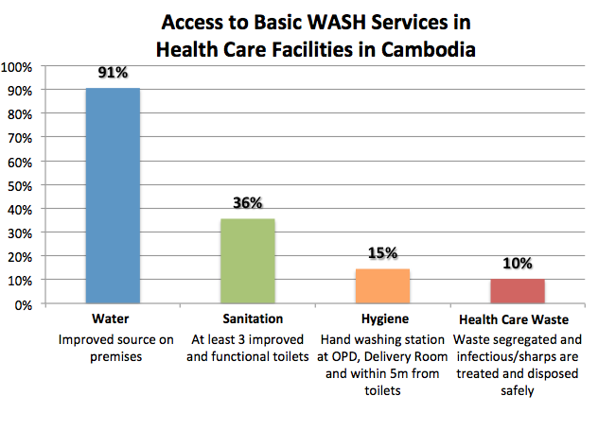
The Country’s Status of WASH in HCFs:
Access to Basic WASH Services
Survey of 117 Health Care Facilities (101 Health Centres and 16 Referral Hospitals in five provinces )
Only 49% -have enough water year round
39%
Source: Por, Ir (2017). Public Health Care Facilities Assessment on Water, Sanitation and Hygiene of Five Provinces in Cambodia. Phnom Penh, Cambodia: National Institute of Public Health.
Notes:
-Findings suggest there is much room for improvement, especially in the areas of hand hygiene and health care waste management

Slide 5
The Country’s Context of WASH in HCFs:
Access to Basic WASH Services
Indicators | Status
Access to basic water supply (water available from improved sources on premises) | All health care facilities: 91% Health centres: 90% Referral hospitals: 93.8%
Access to limited sanitation (at least three improved and usable toilets, but not meeting or meeting some of the needs of specific groups) No HCFs surveyed met global JMP requirements due to gender, accessibility and/or poor sanitation | All health care facilities: 39% Health centres: 36% Referral hospitals: 63% 0%
Access to basic hand hygiene (functional hand hygiene stations available at outpatient department, delivery room/area and within five metres of toilets) | All health care facilities: 15% Health centres: 14% Referral hospitals: 19%
Source: Por, Ir (2017). Public Health Care Facilities Assessment on Water, Sanitation and Hygiene of Five Provinces in Cambodia. Phnom Penh, Cambodia: National Institute of Public Health.
Notes:
-Findings suggest there is much room for improvement, especially in the areas of hand hygiene and health care waste management

Slide 6
National Guidelines for WASH in Health Care Facilities
The guidelines cover the following components:
  Water supply
  Sanitation
  Hygiene
  Management
  Monitoring and evaluation
The guideline aims to:
  Provide guidance on basic WASH services in health care settings.
  Guide necessary WASH improvements in health care settings, including infrastructure, O&M and behaviour practices
  Provide minimum requirements for accreditation and regulation of health care services.

Slide 7
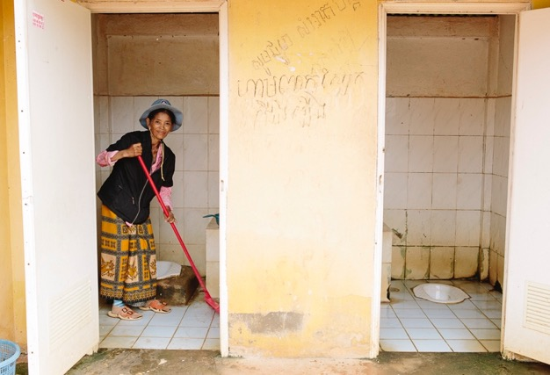
Accessibility Gap in HCFs
Accessing WASH can be challenging for older people, pregnant women and people with disability, due to:
squat toilets with no hand rails
insufficient space in toilets to move around
pathways to toilets and water facilities being difficult to use, particularly for people with limited mobility such as wheelchair users
These challenges are compounded at HCFs. Illness, pregnancy and labour, surgery and other medical procedures can severely affect patients’ mobility, thus additional supports are required for them to access WASH facilities safely and with dignity.
WaterAid/ Tom Greenwood

Slide 8
Methodology to develop the user-friendly tool
Conducted a desk review & key informant interviews: exploring accessible WASH in HCF in existing global guidelines and with Cambodian actors
Developed an accessibility and safety audit tool: assessing WASH in primary HCFs
Led action learning activities: collaborating with diverse actors to develop tools for Cambodian context
Produced practical tools for WASH, health and disability-inclusion actors to use as guidance for improving the accessibility of WASH in HCF
Drove joint leadership to ensure accessible and inclusive WASH in HCF in Cambodia

Slide 9
Developing User-Friendly WASH in HCFs Tool
Held consultations with ante-natal and post-natal HCF users and people with disabilities
Established disability expert review panel (UNICEF, Disability Action Council, Handicap International, MoH)
Led participatory tool testing with health, disability and WASH actors
Collaborated with Handicap International for technical design of accessible WASH in HCF infrastructure
Shared tool with key stakeholders

Slide 10
Users’ Experiences
“One man with disabilities said that, when he needed to use toilet, he needed someone to bring him to the toilet because his wheelchairs did not fit into the narrow door of the toilet.” – People with Disabilities user group
“Some women said that when they changed pad at their bed, sometimes they felt embarrassed with other women who shared the room, so they used curtains for privacy. Sometimes they felt safe when changing pad in bathroom but sometimes they could not go there by themselves because the bathroom was far and they needed someone to accompany.” – Ante-Natal and Post-Natal user group
Rain Water Cambodia

Slide 11
User-friendly tool elements
Section 1: Bathing
Section 2: Sanitation
Section 3: Products and Equipment
Section 4: Handwashing and Drinking water
Section 5: Caring for Young Children and Infants

Slide 12
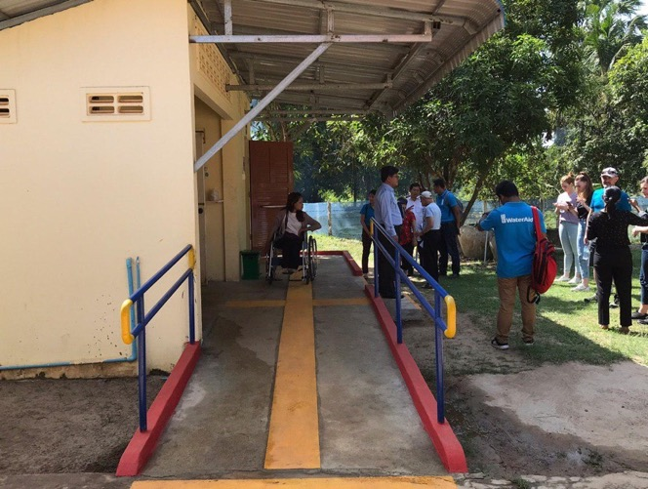
Sun Kimsan/WaterAid

Slide 13
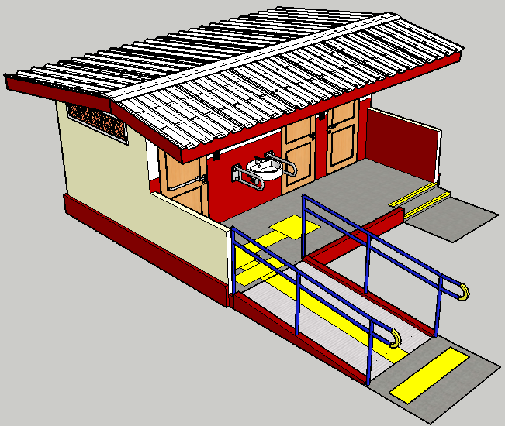
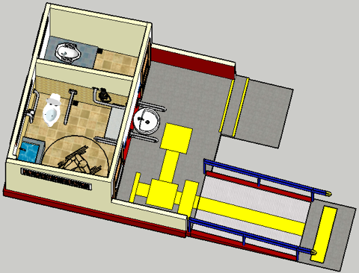
Proposed designs of User-friendly WASH

Slide 14
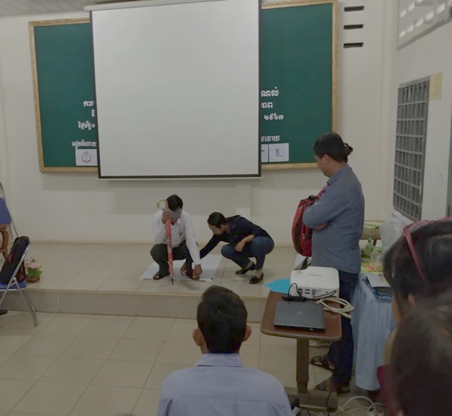
Learning
Three sectors (WASH, Health and Disability) together
  We recognized the need to invest large amounts of time in briefing about this sector-cutting topic.
Adapting the 1/2/3-star rating of WASH FIT into “Accessible WASH in HCF” audit tool
  We learned the importance of investing time to build joint understanding of the rating system.
Health sector acquainted with the design for accessibility limited to a ramp and unlocked toilet door.
  We saw the value of offering a design for accessible WASH in HCF infrastructure.
  Training on the tool need to have accessibility concept to participants (HCWs, tool user)
  This tool is adapting with primary HC setting not try with hospital
WaterAid/ Ret Senghort

Slide 15

Acknowledgements
Hospital Service Department, NGOs’ partners, Health Care Providers, Health care users and Disabled People Organizations

Slide 16
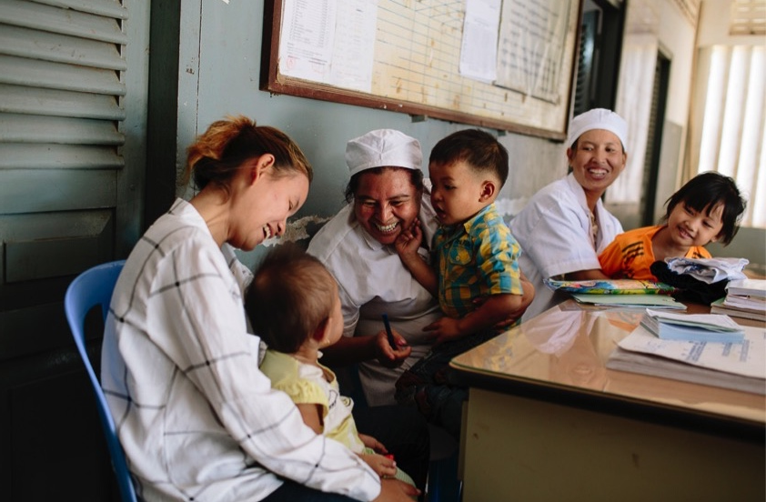
Thank You
Thank You
Thank you!
WaterAid/ Greenwood
WaterAid/ Tom Greenwood

